Slide 1

Department of ECE
ANALOG ELECTRONIC CIRCUIT DESIGN 22EC2104A
CO-2
Session-9 Common gate amplifier

Slide 2



AIM OF THE SESSION
To familiarize students with the operation of common gate amplifier
INSTRUCTIONAL OBJECTIVES
This Session is designed to:
Give introduction amplification in CG configuration
To analysis operation of CG amplifier
LEARNING OUTCOMES
At the end of this session, you should be able to:
1. Describe the working of CG amplifier circuits.
2. Demonstrate and analyze the operation and parameters of CG amplifier.

Slide 3
Introduction
A common gate amplifier is a configuration of a field-effect transistor (FET) amplifier commonly used in electronic circuits.
In this setup, the input signal is applied to the source terminal, while the output is taken from the drain terminal.
The gate terminal is connected to a common reference point.
The common gate amplifier provides voltage amplification and offers a low input impedance, making it suitable for interfacing with signal sources that have low output impedance.
It exhibits high input and output isolation, which can be advantageous in certain applications. The common gate amplifier is commonly used in RF amplification, buffer stages, and impedance matching circuits due to its unique characteristics and performance attributes.

Slide 4
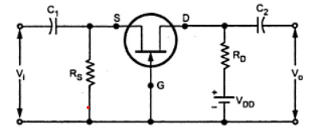
Common gate amplifier
In this circuit, input is applied between source and gate and output is taken between drain and gate.
In CG Configuration, gate potential is at constant potential. so, increase in input voltage Vi in positive direction increase the negative gate source voltage.
Due to ID reduces; reducing the drop IDRD. Since VD= VDD-IDRD, the reduction in ID results in an increase in output voltage.

Slide 5
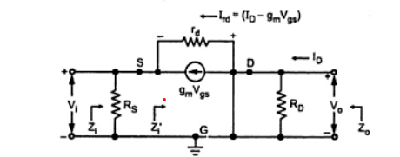
Analysis

Slide 6
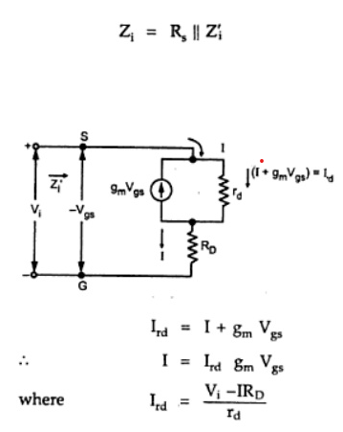
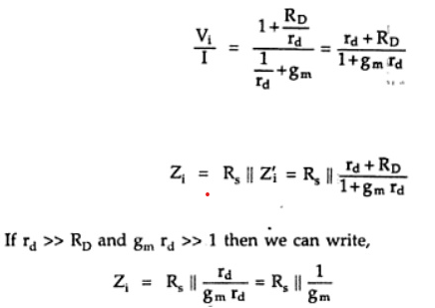
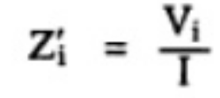
Input impedance (Z_{i})
After substituting and simplification

Slide 7
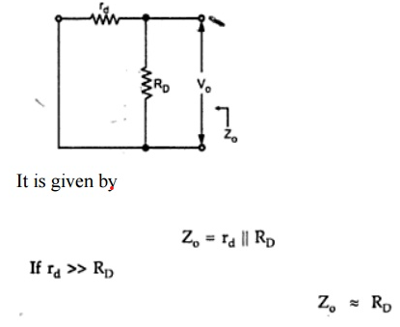
Output impedance Z_{o}

Slide 8
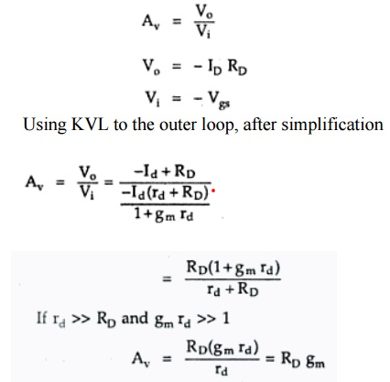
Voltage gain (Av)

Slide 9

SUMMARY
A common gate amplifier is a type of field-effect transistor (FET) amplifier configuration commonly used in electronic circuits.
In this setup, the input signal is applied to the source terminal, and the output is taken from the drain terminal, while the gate terminal is connected to a common reference point.
The common gate amplifier provides voltage amplification and exhibits a low input impedance, making it suitable for interfacing with signal sources that have low output impedance.
It also offers high input and output isolation, which can be beneficial in specific applications.
Common gate amplifiers find application in RF amplification, buffer stages, and impedance matching circuits due to their unique characteristics and performance attributes.

Slide 10
SELF-ASSESSMENT QUESTIONS
1. The voltage gain of the common-gate amplifier is primarily determined by the:
a) Load resistor
b) Drain resistor
c) Source resistor
d) Gate resistor
2. The common-gate amplifier exhibits a relatively:
a) High input impedance and low output impedance
b) Low input impedance and high output impedance
c) High input impedance and high output impedance
d) Low input impedance and low output impedance

Slide 11
TERMINAL QUESTIONS
1. Draw the small signal model of common gate amplifier
2. Find the input impedance and voltage gain of common gate amplifier

Slide 12
REFERENCES FOR FURTHER LEARNING OF THE SESSION
Reference Books:
1. Jacob Millman - “Electronic Devices and Circuits”, 4th Edition, McGraw Hill Education (2015)
2. D Roy Choudhury and Shail B. Jain – “Linear Integrated Circuits”, 4th Edition, New Age International Pvt.Ltd. (2017)
3. David A. Bell - “Electronic Devices and Circuits”, 5th Edition, Oxford University Press (2008)
Sites and Web links:
https://www.learnelectronicswithme.com/2020/07/what-is-jfet-construction-and-working.html
https://electronicspost.com/explain-the-construction-and-working-of-a-jfet-what-is-the-difference-between-a-jfet-and-a-bjt/
https://electronicsdesk.com/junction-field-effect-transistor.html

Slide 13
THANK YOU
Team – ANALOG ELECTRONIC DEVICES AND CIRCUITS

